Slide 1
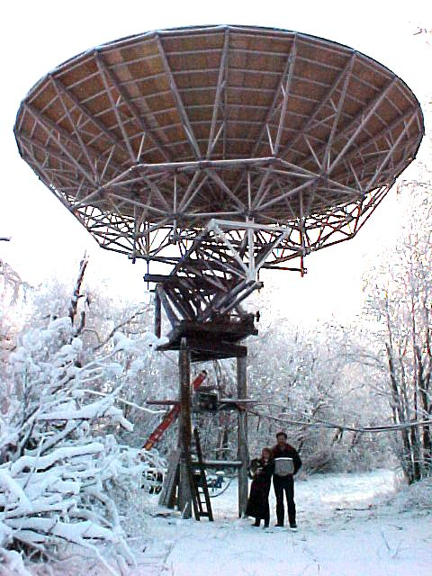
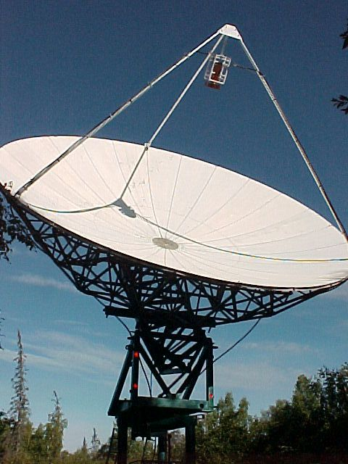
Earth Moon Earth Communications
The Ultimate Amateur Radio Challenge
By Mike Melum, KL6M
Presented to Motley Picnic 2026

Slide 2
Contents
Bio
Motivation
How I got hooked
History
The steps to building an EME station
  Design
  Procure
  The Tower
  The Mechanics
  Electrical/Electronic
You can do EME

Slide 3
Bio
Grew up in SoDak, Ham in 1965
EE SDSU – US Army
FAA Chicago 1974
Indiana, Michigan, Minneapolis, OKC, DC,
  Alaska 1992, on 3-5 year assignment
Acquired my EME obsession, 1999
Wife Lana is very tolerant of my obsession

Slide 4
MOTIVATION
I acquired an unusual relationship with the Moon
Typically about 0.5 degree of arc
The thought of reflecting a signal off the moon is seemingly absurd considering:
  Average 238,000 miles from Earth +/- 14,000 miles
  Only 7% reflective
  Huge path loss; hundreds of dB

Slide 5
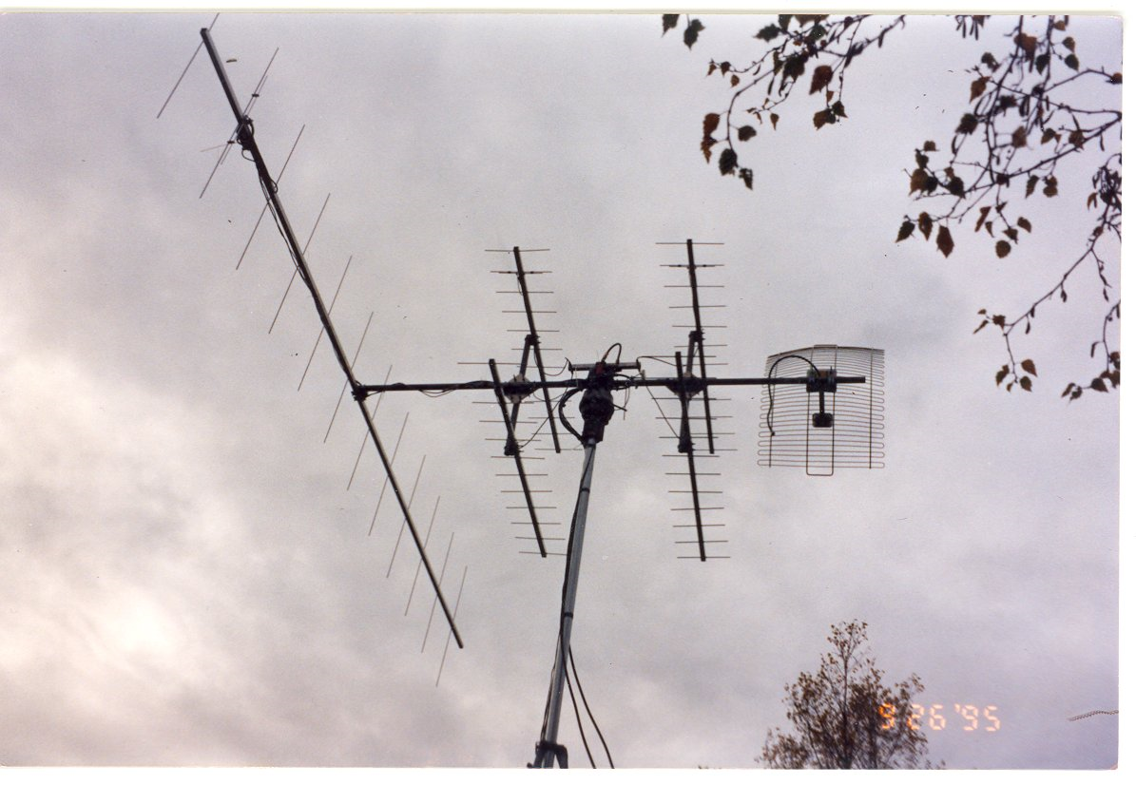
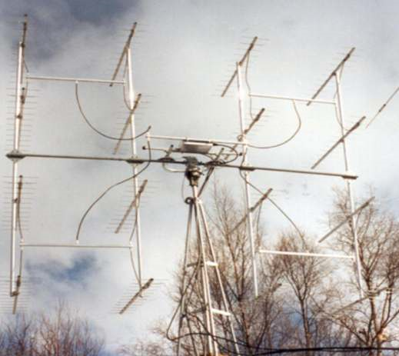
How I got Hooked
Amateur Satellites in 1992 until about 1998
1997 EME contest, heard my 1st moon signal
The Ultimate ham radio challenge – EME

Slide 6
Hooked
Technology “Sport”
  Civil, Mechanical, Electrical, Electronic Engineering
  Astrophysics – Moon dynamics are complicated
  Control systems
  High Power Amplifiers
  Low noise, high sensitivity receivers
EME Attracts all kinds of people from carpenters to Nobel Prize winners (~3000 world-wide?)

Slide 7
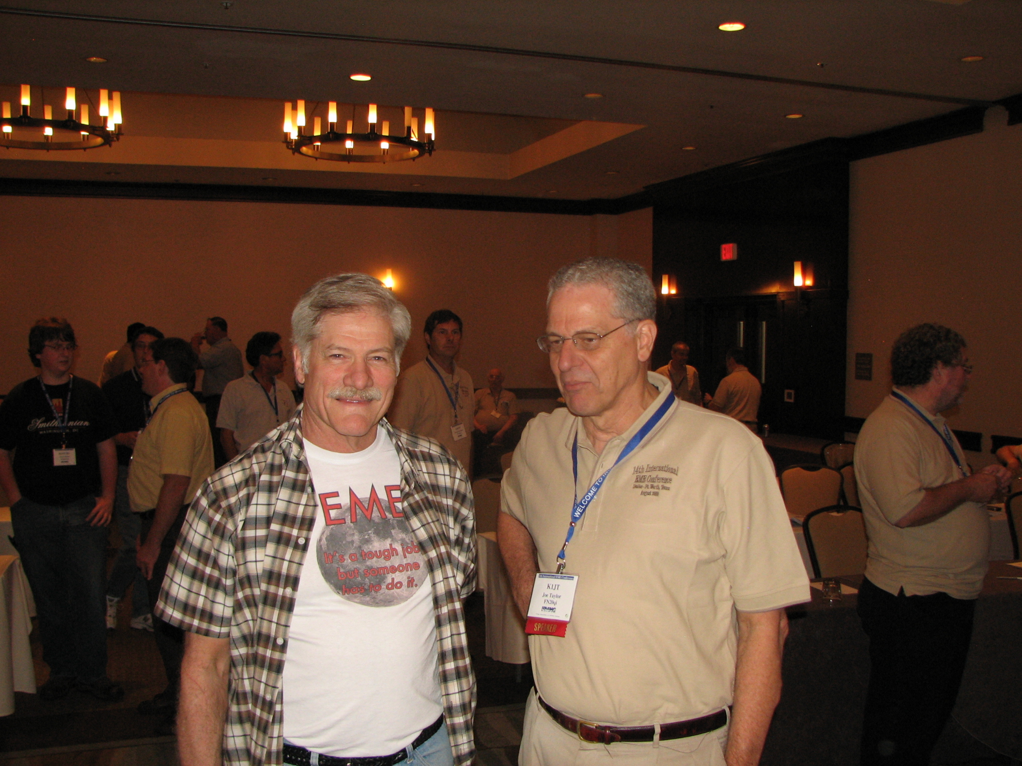
WSJT Inventor and EME’er and Nobel Prize Winner

Slide 8
History
The first EME projects started just after the conclusion of WWII.
Project Diana, 1946 - Radar echoes
US Navy's Moon Relay project in 1951
1960: The first amateur two-way EME contact
By 2000 estimated 1000 amateurs worldwide had successfully completed at least one EME QSO.
Estimated ~3000 EME capable stations today.

Slide 9
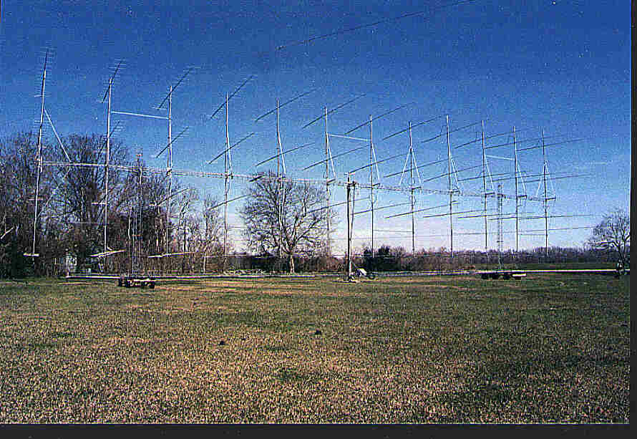
Thanks to W5UN

Slide 10
The Steps
(to building an EME superstation)
Acquire the Dish
Design
Procure parts, materials, services
The mounting structure (Tower)
The Mechanics
The Electronics
OPERATE !

Slide 11
Structural Design
Tower Requirements
  Strength (wind and weight)
  Height
  Cheap ?
Mechanical concepts
Make Drawings
Ask everyone!

Slide 12
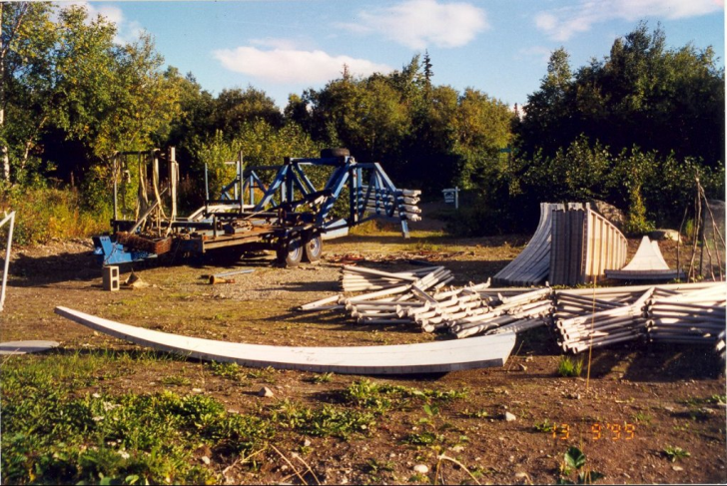
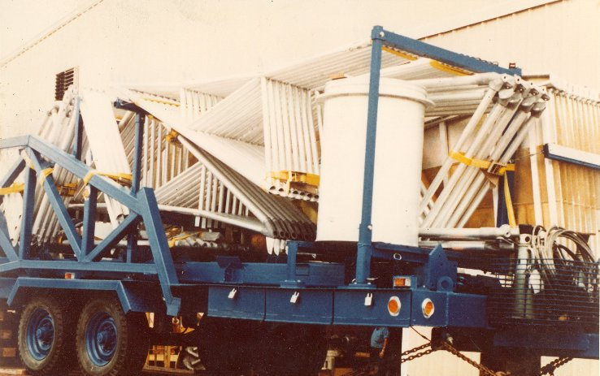
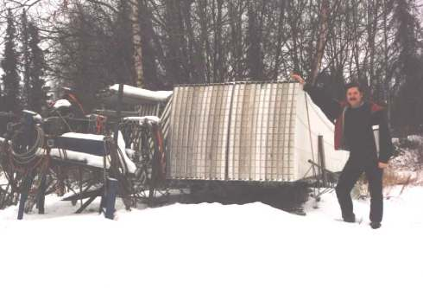
Acquire a Dish (1999)

Slide 13
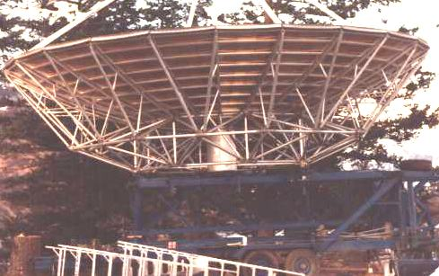
Original Transportable Dish

Slide 14
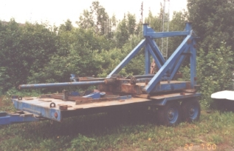
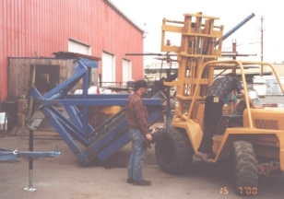
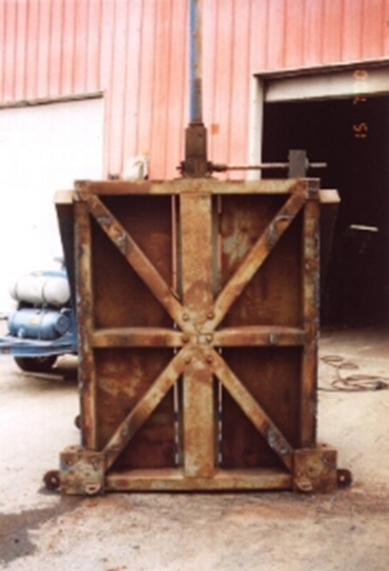
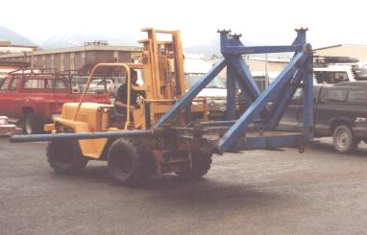
Modifications

Slide 15
Design
WINDLOADING AND FOUNDATION CALCULATIONS
The following assumptions were used in the calculations:
1. Design windspeed ? 50 lbs/sq.ft. (approx. 120 mph)
2. Dish area = 700 sq. ft.
3. Maximum operating wind = 35 mph
4. Total weight of movable antenna = 6,000 pounds
5. Decision: Design for worst case in parked position
6. Design is with antenna parked (EL = 90; AZ = 150 +/-10)
(Historically most winds in excess of 30 mph are from this
direction)
7. Locked with grade 8 x 1” bolt above 35mph

Slide 16
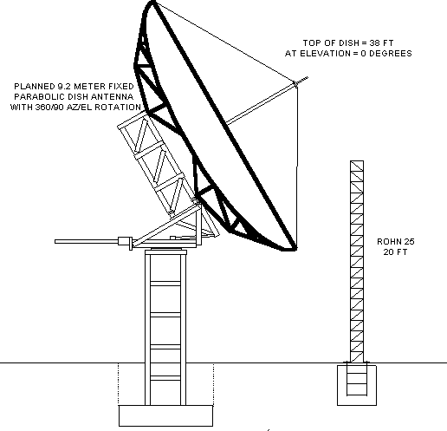
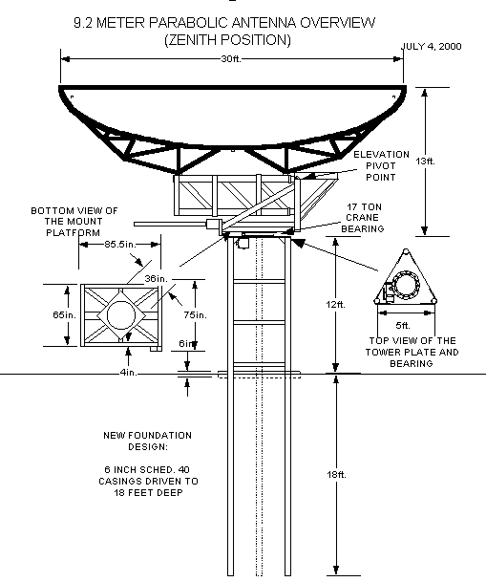
Alternatives

Slide 17
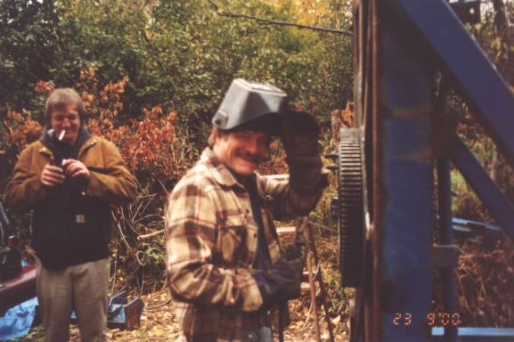
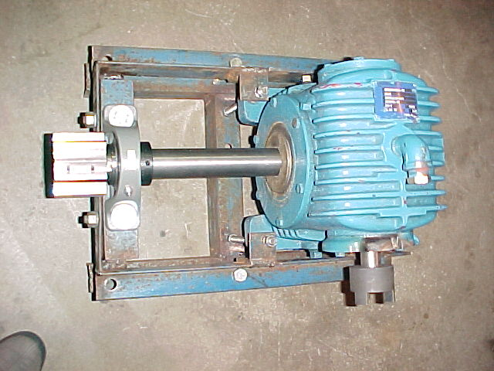
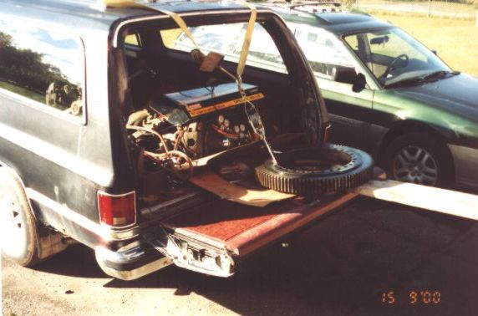
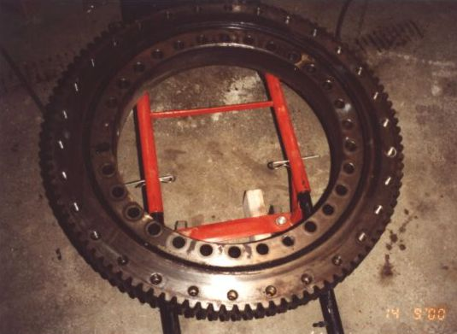
Beg, Borrow, Barter

Slide 18
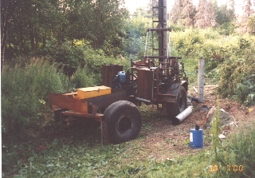
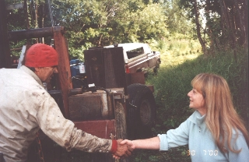

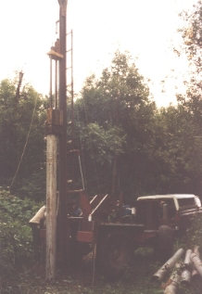
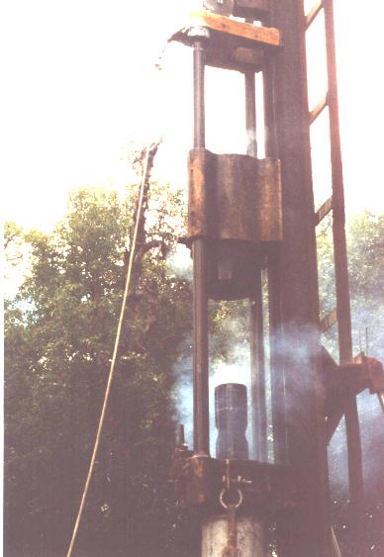
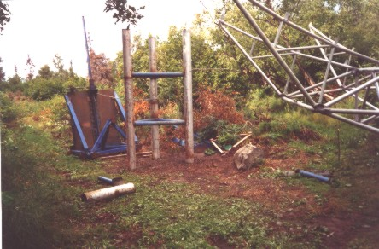
Tower (Pilings)

Slide 19
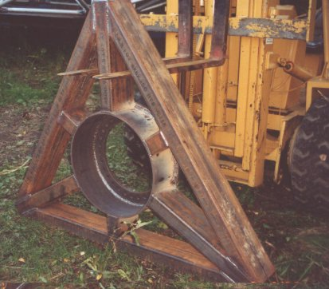
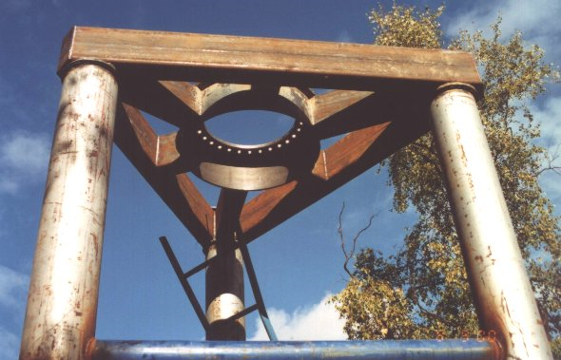
Tower Top

Slide 20
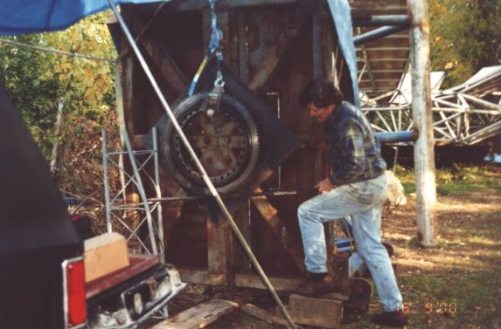
Rotating Platform

Slide 21
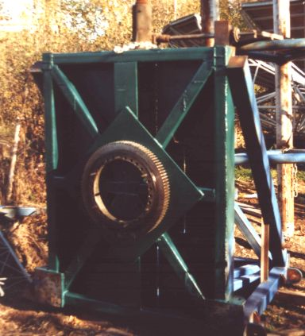
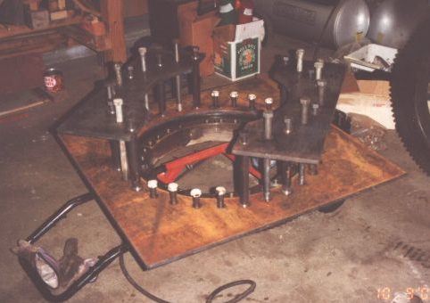
Rotating Platform (Part 2)

Slide 22
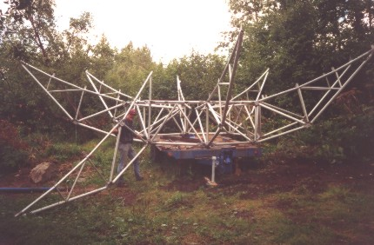
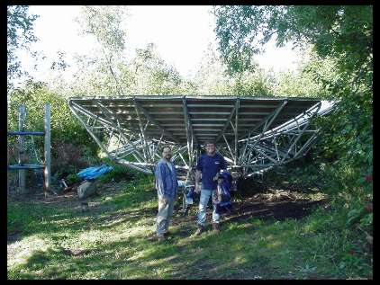
Dish Assembly

Slide 23
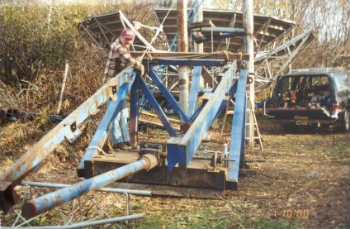
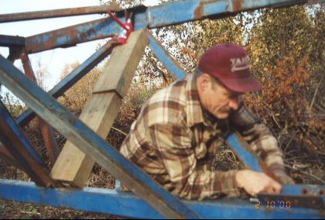
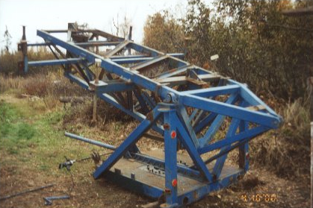
Lift Frame

Slide 24
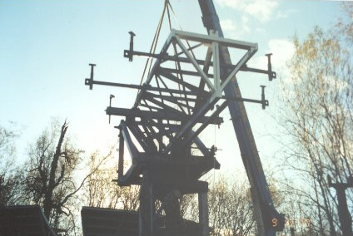
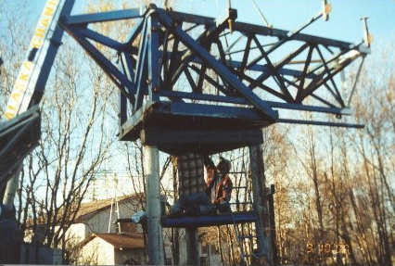
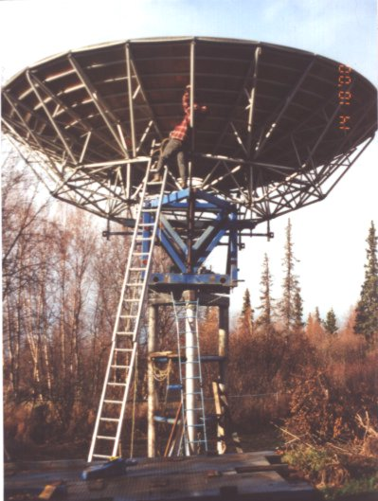
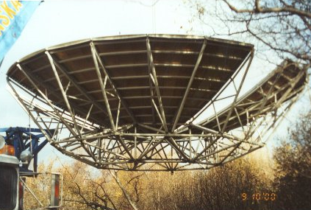
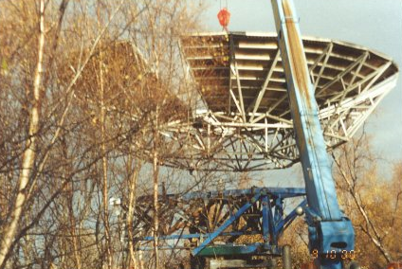
Crane

Slide 25
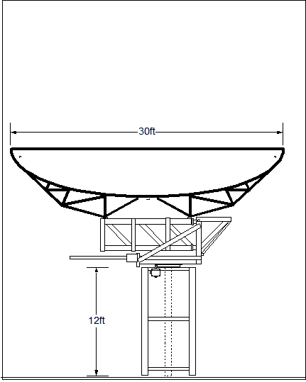
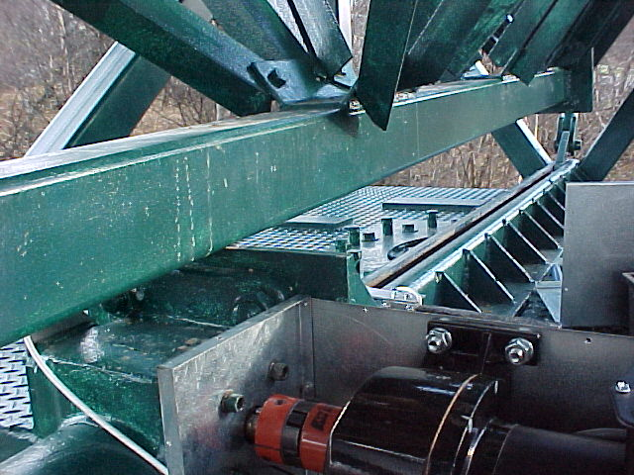
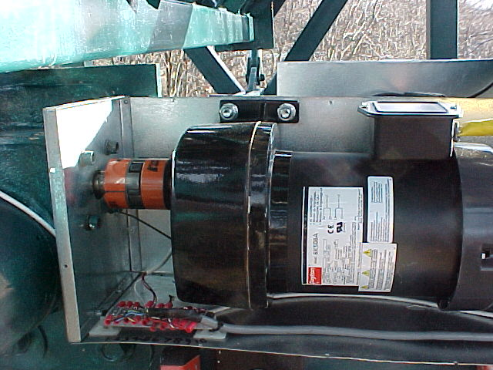
Elevation Actuator

Slide 26
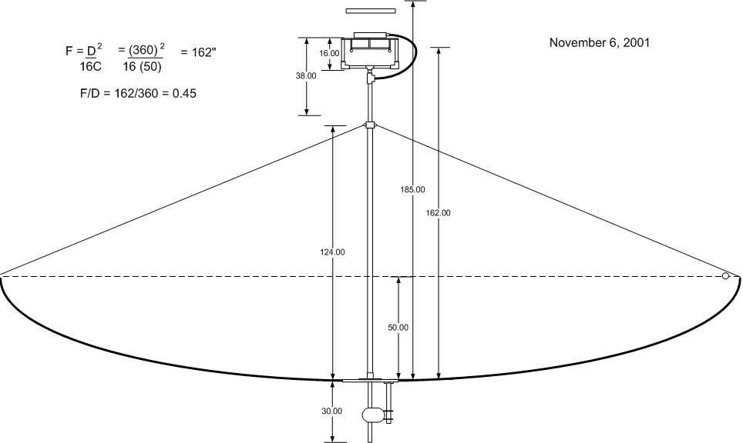
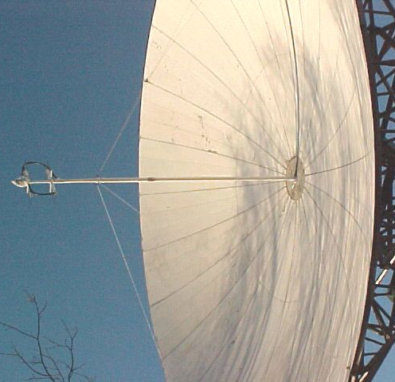
Mounting the Feed
Phase 1
Then my wife caught me changing feeds

Slide 27
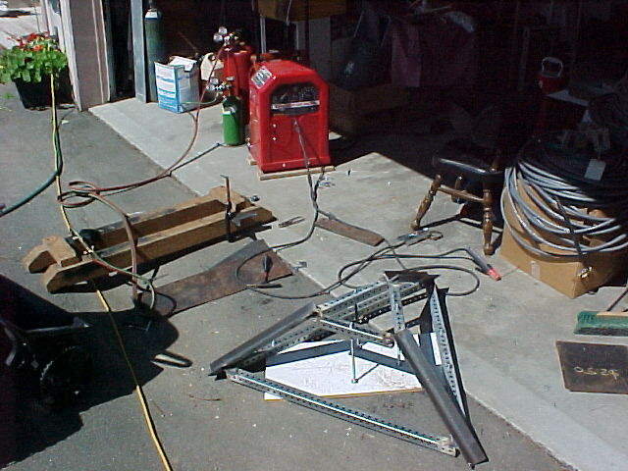
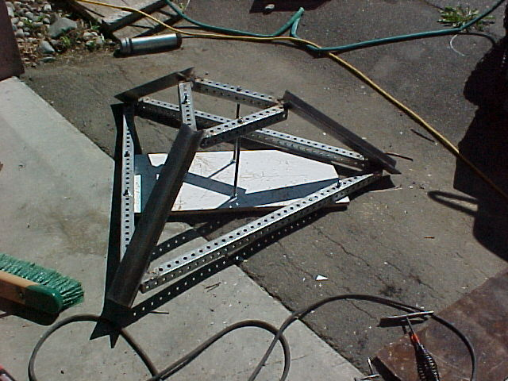
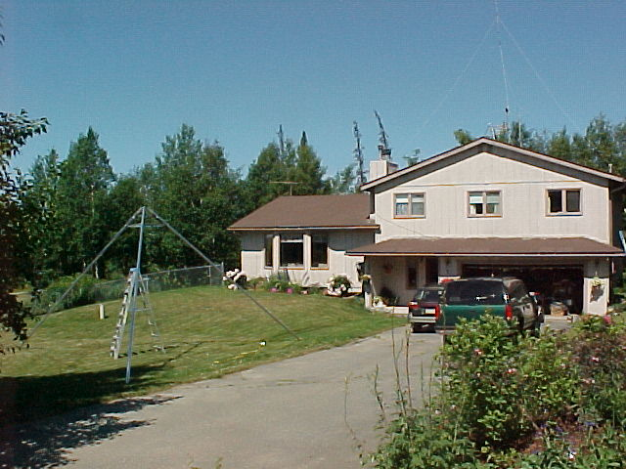
Mounting the Feed
Phase 2 (First Attempt)

Slide 28
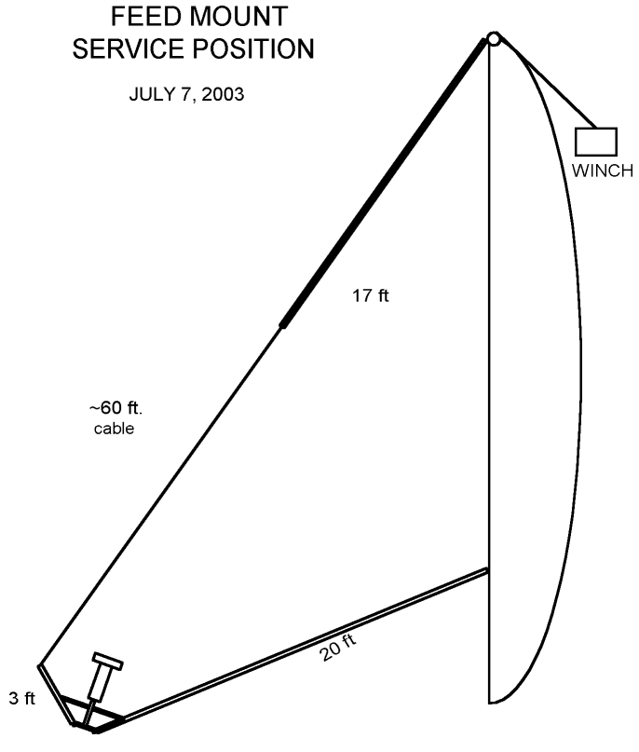
Mounting the Feed
Phase 2 (Final Solution)

Slide 29
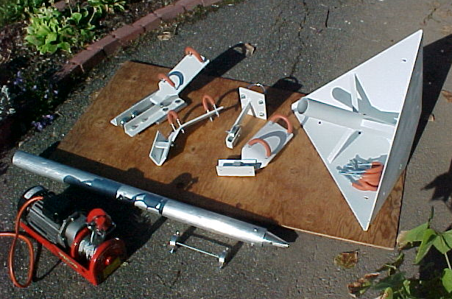


Mounting the Feed
Phase 2 (First Attempt) (Continued)

Slide 30

FEED WINCH OPERATION

Slide 31



DIY
ANTENNA POSITION AND TRANSMIT CONTROL PANEL

Slide 32
System Block

Slide 33

Fabrication Bench

Slide 34

Test Bench

Slide 35

Operating Console

Slide 36

Antenna Control

Slide 37

TYPICAL MOON EVENT

Slide 38

QRV EME on 9 Bands

Slide 39
Your Future EME System

Slide 40


Lesotho
MOON TRACKING PROGRAM

